Slide 1

Practical Algorithms for Computing STV
Chunheng Jiang, Sujoy Sikdar, Hejun Wang, Lirong Xia, Zhibing Zhao

Slide 2
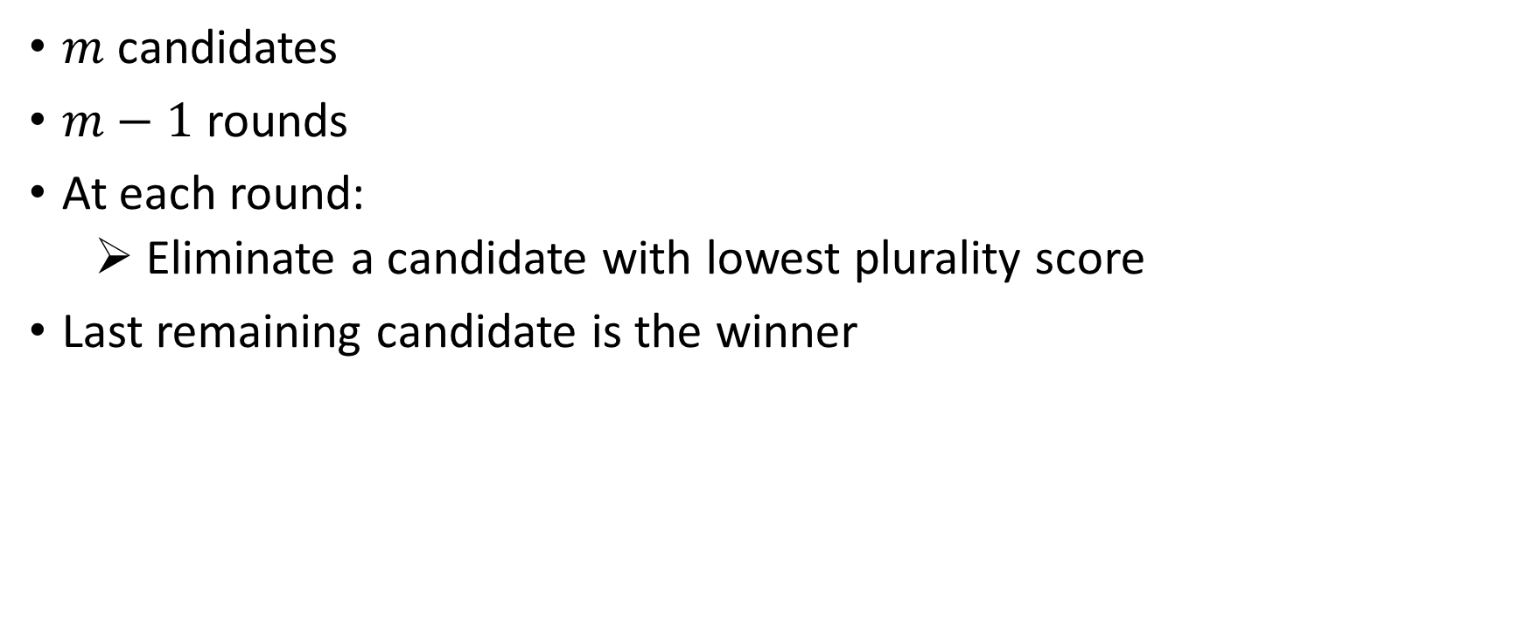
Single Transferable vote
$m$ candidates
$m−1$ rounds
At each round:
Eliminate a candidate with lowest plurality score
Last remaining candidate is the winner
Notes:
You have probably seen this definition many times

Slide 3



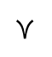
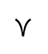
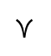
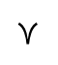
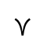
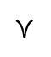
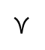
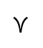
Single Transferable Vote: Multi-round voting
# votes
4
2
1
3
4
2
1
3
$$≻$$
$$≻$$
$$≻$$
$$≻$$
$$≻$$
$$≻$$
$$≻$$
$$≻$$
Winner!
plurality
score
4
3
3
4
6

Slide 4
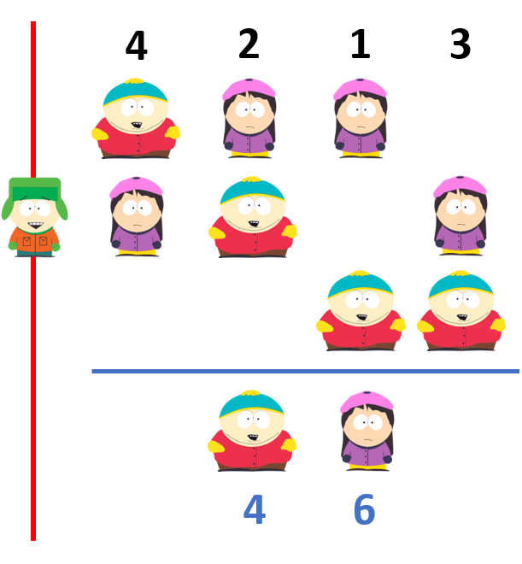
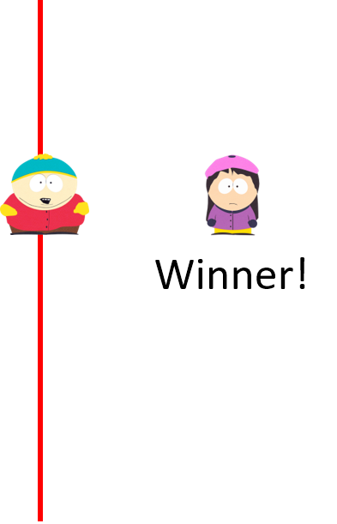
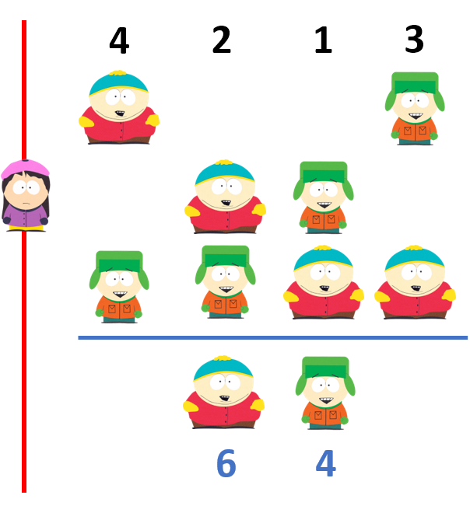
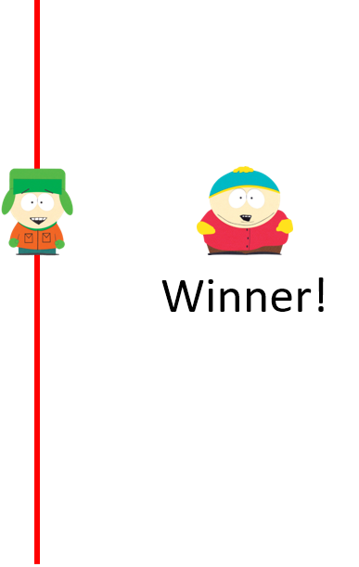
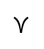
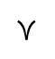
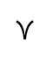
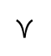
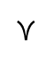
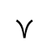
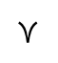
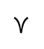
How should ties be broken?
4
2
1
3
$$≻$$
$$≻$$
$$≻$$
$$≻$$
$$≻$$
$$≻$$
$$≻$$
$$≻$$
4
3
3
Parallel-Universe-Tiebreaking (PUT) – STV [Conitzer et al. 2009]
Notes:
Winner depends on the tie breaking rule.
Under PUT-STV, there may be multiple co-winners
Also in Ranked Pairs, Baldwin’s and Coomb’s rule.

Slide 5
Ties are real
9.2% of Preflib profiles have more than one STV co-winners.
On average 1.1 co-winners in Preflib data.
Greater transparency in voting rule implementation.
Random elimination of ties not the solution.
Computing all co-winners for STV, and other rules is NP-hard. [Conitzer et al. ‘09, Mattei et al. ‘14]

Slide 6
When COMSOC starts
Complexity of Kemeny and Dodgson’s rule [Bartholdi et al. ‘89]
Computing Kemeny winners:
104 algorithms compared [Ali and Meila, ‘12]
STV has been overlooked.
Used in Australia, Canada, India, UK, US
Computing winners using Map Reduce [Csar et al. ‘17]
P-complete for STV using fixed tie breaking
Notes:
Is it the very first paper?
Winner determination is one of the first problems
Kemeny is most common
Several theoretical results
104 algorithms compared

Slide 7
Main messages
Winner computation has been overlooked
STV, ranked pairs, Coombs, Baldwin…
Standard search algorithms work for small elections
New frontier: Machine learning for COMSOC
Notes:
Winner computation for STV has been overlooked
More exciting: Machine learning can help for COMSOC problems
We are very excited about ML helping many other problems in COMSOC

Slide 8
Winner Determination Problem
Input: Preferences
Output: co-Winners
Criteria
Running time
Early discovery
Notes:
Examples: Picking a restaurant with friends, Meeting location, etc.
Voting rule doesn’t know the priority function.
Computational challenges.
Possibly large # candidates, large # ties.

Slide 9



Online, high frequency voting
Want: Anytime algorithms
Notes:
Concrete example: During GM week, every algorithm we can give no more than 1 second to compute live results which I am going to talk about. Otherwise, the system will get blocked and delay everything. In fact, this problem was even faced when we used opra for a small class and everybody submitted their votes together.
Expand on anytime algorithm
Report possible co-winners within time bounds.
Time constraints
Live results
Resource constraints
Memory, storage, processing
E.g. Estonia elections, RPI GM week.

Slide 10

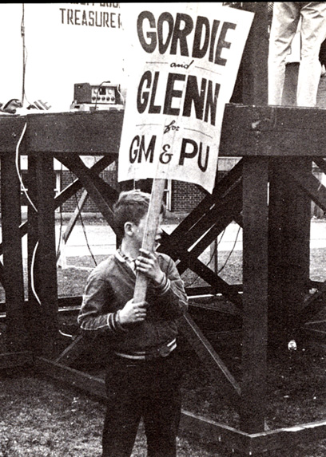
RPI Grand Marshall Week
The Grand Marshal (GM) is the highest elected student leader of RPI [wiki]
Annually since 1865
152 GMs
A full week of events
active campaigning
debates
primary/general elections
Notes:
Whole week of activity
Live debates, primaries, followed by general elections

Slide 11
Online voting becomes real
RPI switched to “online” voting in 2015
Google form
Long line
Only vote for top choice
We can build a better system
Rank the candidates? Yes
Complicated mechanism? No
Live results? Maybe
Cyber security?
Disclaimer: I am not advocating for online voting
Notes:
Selling point was the we allowed users to rank the candidates

Slide 12

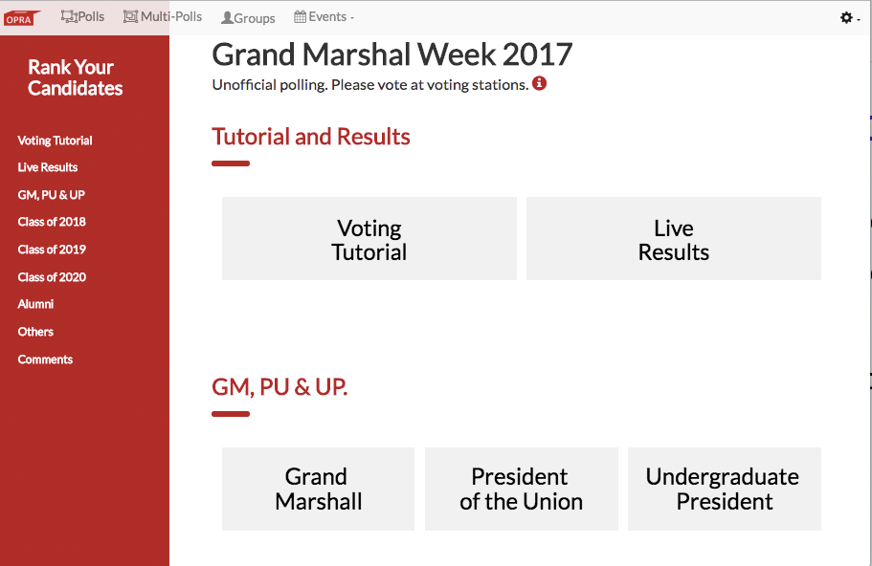
Online Preference Reporting and Aggregation

Slide 13
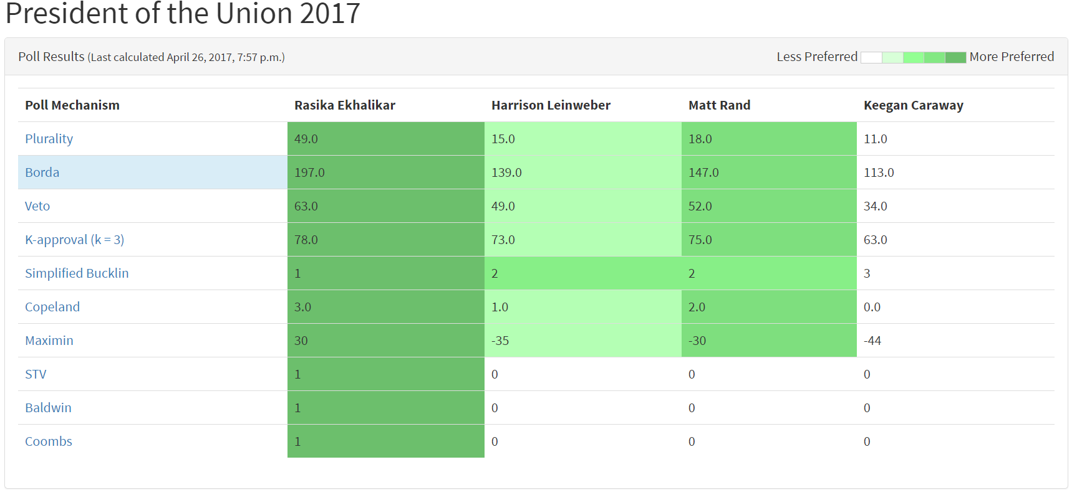
Live Results
Include picture
Notes:
This is high frequency voting. Every time a vote is submitted. Updated every few seconds. Justifies anytime property.

Slide 14
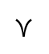
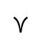
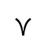
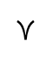
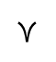
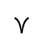
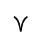
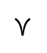
As an AI search/exploration problem
4
2
1
3
$$≻$$
$$≻$$
$$≻$$
$$≻$$
$$≻$$
$$≻$$
$$≻$$
$$≻$$
4
3
3
Notes:
This is NOT a standard search problem. Because there is no goal test.
States encode the remaining candidates.
Add preference symbols to profile
State space: Remaining candidates.
Start state: Everyone.
Successor function: Eliminate a candidate.
Output: co-Winners.

Slide 15


Standard tricks
…
…
…
…
Store in cache
X
Prune
…
Caching
Pruning
Reduction
Sampling

Slide 16
Experimental Setup
Preflib data
Synthetic data
Profiles generated i.i.d.
Only use hard cases: at least one tie in the execution of STV
Notes:
Focused on hard cases

Slide 17
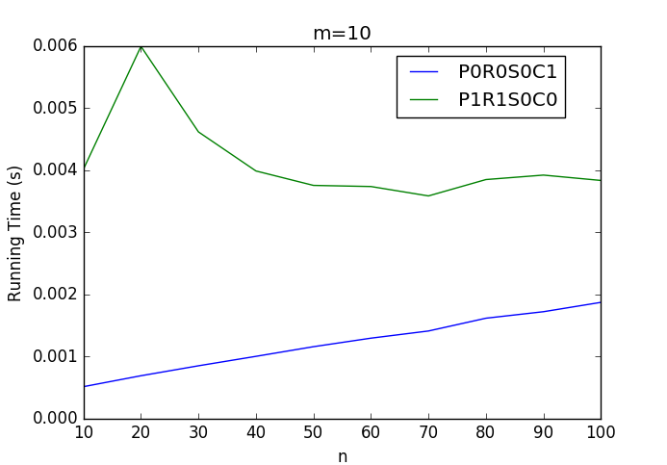
Caching helps Depth First Exploration
no caching
with caching
Peak in avg. # co-winners around n=20

Slide 18
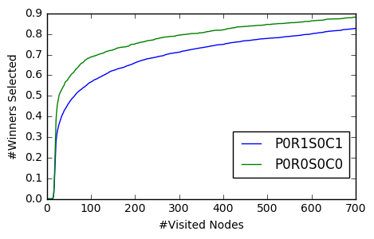
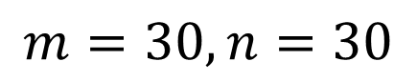
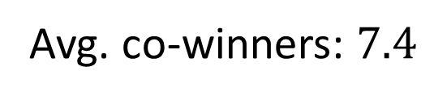
Early discovery: # co-winners / # states
pruning, caching
plain
proportion of co-winners
$$m=30,n=30$$
Avg. co-winners: $7.4$
Notes:
Chunheng: two curves only, caching and no caching

Slide 19
Exploring more intelligently
Prioritize states that lead to a new winner
Priority function:
To aid early discovery
Reduce # nodes expanded
Idea for priority function
If we had better knowledge of co-winners in each state
$$α_{1}∗\# new winners+α_{2}∗depth+α_{3}∗\#new winners∗depth$$
estimated by machine learning

Slide 20
Machine Learning for STV
Features
Weighted Majority graph
Positional matrix
Borda, Copeland, Maximin score
LP relaxation
Learning algorithms tried:
Neural networks
Logistic
SVM – linear, rbf
Deep learning
Notes:
We also have ILP to compute STV winners with polynomial no. of winners and constraints
LP relaxation, a polynomial time computable feature
Winners computed by the LP must be a superset of true winners

Slide 21
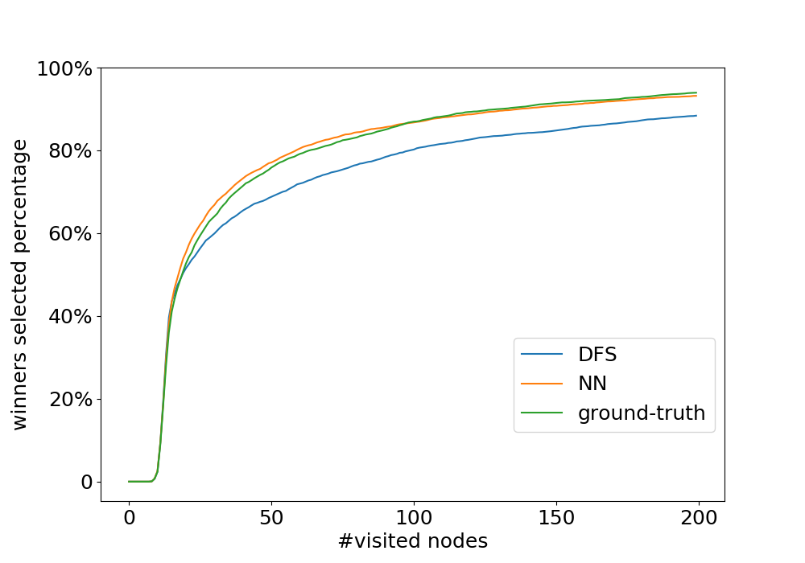
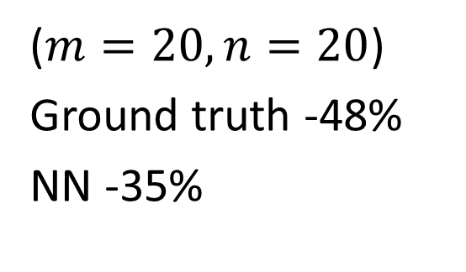
Machine learning for early discovery
($m=20,n=20$)
Ground truth -48%
NN -35%
Notes:
To us this is surprisingly good
In # states explored for computing all winners
We are using ML to solve an NP-hard problem. We are not interested in the output of the ML algorithm itself. We are using it as a heuristic.
Our result is absolutely correct. Not PAC. Its never wrong.
NN works better in some regions

Slide 22
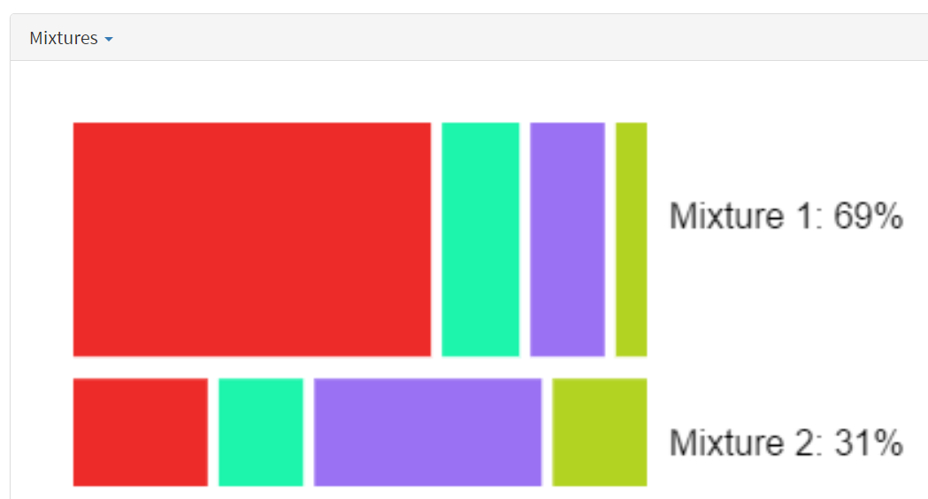
Summary and future work
Winner determination problem revisited
STV, ranked pairs, Coombs, Baldwin…
Standard AI algorithms may work
Machine learning can help
Deep learning
Reinforcement learning
New frontier: Machine learning for COMSOC
Other multi-round rules
Other classical COMSOC problems: Kemeny, multi-winner rules, manipulation, bribery, margin of victory, possible/necessary winners
Measuring and visualizing consensus: voting blocs
Designing new rules [Xia ‘13 AAMAS]
Thank You
Notes:
A personalizable or customizable set of properties.

Slide 23
Thank You

Slide 24
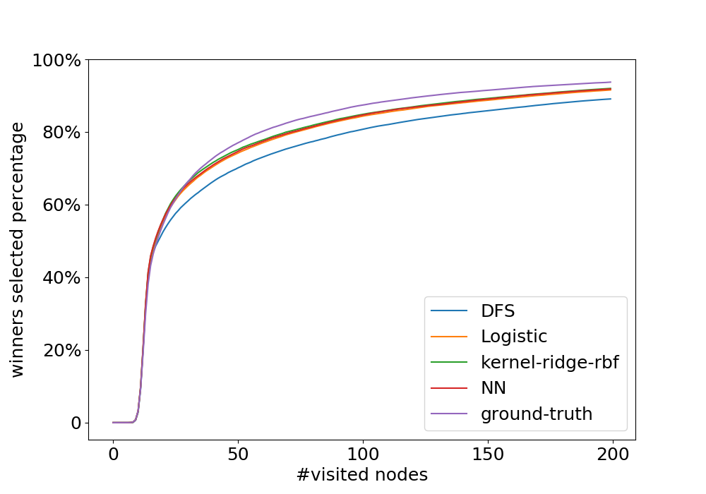
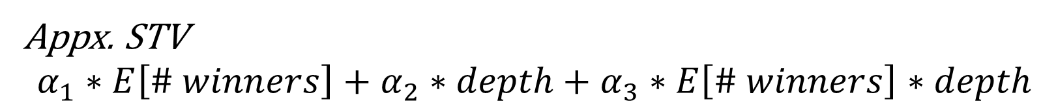
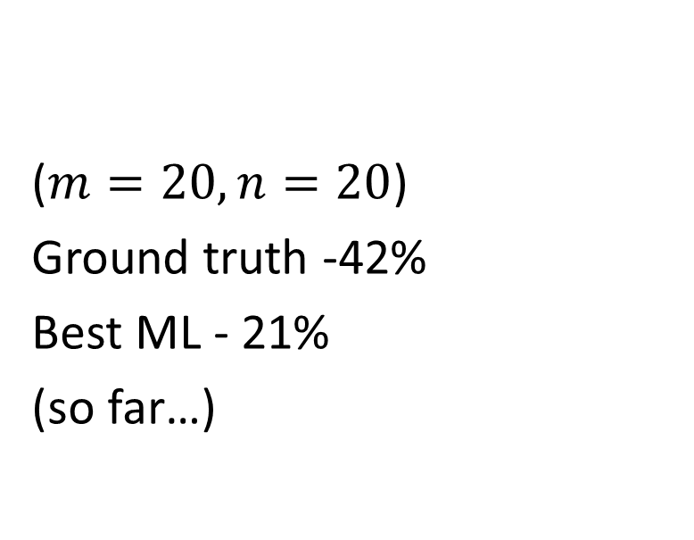
Machine Learning for early discovery
Appx. STV
$$α_{1}∗E\left[\# winners\right]+α_{2}∗depth+α_{3}∗E\left[\# winners\right]∗depth$$
($m=20,n=20$)
Ground truth -42%
Best ML - 21%
(so far…)
Notes:
First approach: use ML to learn STV. NP-hard problem
Still learning STV but use it as a middle step to guide the search.
Develop a heuristic
Jun: 0-200
Live results, have to set a cap on running time
Not running time, # states explored

Slide 25
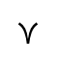
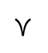
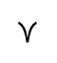
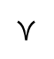
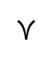
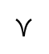
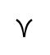
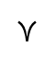
Voting: Single winner rules
Candidates:
4
2
1
3
Votes:
$$≻$$
$$≻$$
$$≻$$
$$≻$$
Voting Rule
$$≻$$
$$≻$$
$$≻$$
$$≻$$
Single Winner
(by Plurality)

Slide 26
Comparison with ILP formulation

Slide 27
Ongoing work
Practical algorithms for common voting rules.
Baldwin’s, Coomb’s, Kemeny
Natural formuations as AI search/exploration
Reinforcement learning, Machine learning to:
guide heuristics for AI exploration
mechanism design

Slide 28
Previous work for Kemeny
Structurally hard even without tie breaking
New frontier
Natural question, not addressed.
Big picture: Can ML help Soc. Choice.
Deep learning to design auction rules
ML to help design
ML guided heuristic design
What about other problems?
Manipulation
Kemeny

